Slide 1
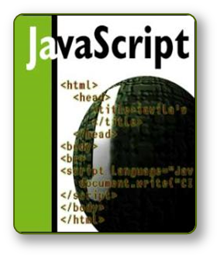


JavaScript
DOM & Form Validation

Slide 2
DOM
JavaScript also provides you with objects that can control and manipulate the displays of browsers.
  More dynamic and interactive.
DOM is an object-oriented model that describes how all elements in an HTML page are arranged.
It is used to locate any object in your HTML page (an unique address).

Slide 3
How the DOM works?
<head><script>
function toggle()
{ document.img.button1.src=“button_on.gif”; }
</script></head>
<body>
<a href=“test.html” onmouseover=“toggle()”> <img name=“button1” src=“button_off.gif”></a>
</body>
reaction
action
Action
Event
JavaScript
DOM
Reaction
src=“button_off.gif”
onmouseover
toggle()
document.img.button1
Src=“button_on.gif”
User moves mouse over object
Event senses that something happened to the object
JavaScript tells the object what to do (Even handler)
Locates object on the web page
Object’s image source is changed

Slide 4
DOM
window
document
frame
location
history
anchor
image
form
link
button
checkbox
radio
select
reset
textarea
text
submit

Slide 5
Common DOM Events
Mouse events:
  onclick, onmousedown, onmouseup
  onmouseover, onmouseout, onmousemove
Key events:
  onkeypress, onkeydown, onkeyup
  Only for input fields
Interface events:
  onblur, onfocus
  onscroll

Slide 6
Common DOM Events (2)
Form events
  onchange – for input fields
  onsubmit
    Allows you to cancel a form submission
    Useful for form validation
Miscellaneous events
  onload, onunload
    Allowed only for the <body> element
    Fires when all content on the page was loaded / unloaded

Slide 7
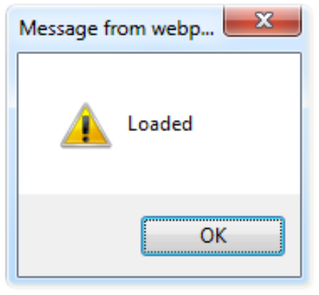
onload Event – Example
  onload.html
onload event
<html>
<head>
<script type="text/javascript">
function greet() {
alert("Loaded.");
}
</script>
</head>
<body onload="greet()" >
</body>
</html>

Slide 8

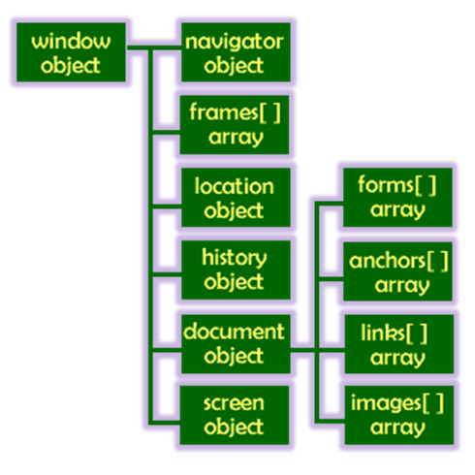

The Built-In Browser Objects

Slide 9
Built-in Browser Objects
The browser provides some read-only data via:
  window
    The top node of the DOM tree
    Represents the browser's window
  document
    holds information the current loaded document
  screen
    Holds the user’s display properties
  browser
    Holds information about the browser

Slide 10
DOM Hierarchy – Example
window
navigator
screen
document
history
location
form
form
button
form

Slide 11
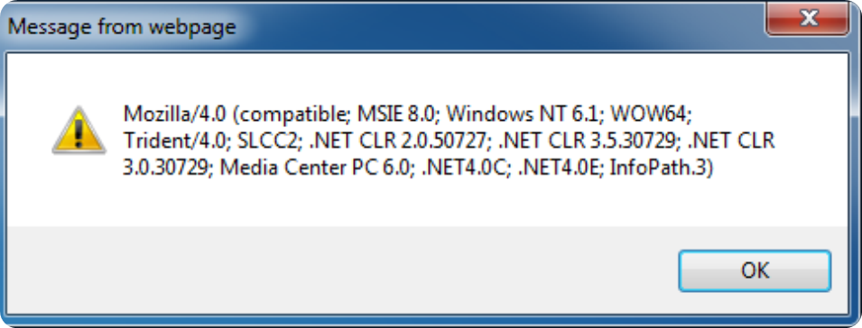
The Navigator Object
alert(window.navigator.userAgent);
The browser window
The navigator in the browser window
The userAgent (browser ID)

Slide 12
Properties and methods of the “window” Object
Method | Description
alert(text) | Pop up a window with “text” as the message
close() | Closes the current window
open(url) | Open a new window populated by a URL.
setTimeout(expression, time) | Executes an expression after the elapse of the interval time.
Property | Description
length | An integer value representing the number of frames in the window
name | A string value containing the name of a window
parent | A string value containing the name of the parent window
status | A string value representing status bar text

Slide 13
window.open()
Opening and closing windows
Window attributes of the “open()” method
Attribute | Description
toolbar | Creates the standard toolbar
location | Creates the location entry field
directories | Creates standard directory buttons
status | Creates the status bar
menubar | Creates the menu bar at the top of a window
scrollbars | Creates scrollbars when the document exceeds the window size
resizable | Enables the user to resize the window
width | Specifies the width of the window
height | Specifies the height of the window

Slide 14
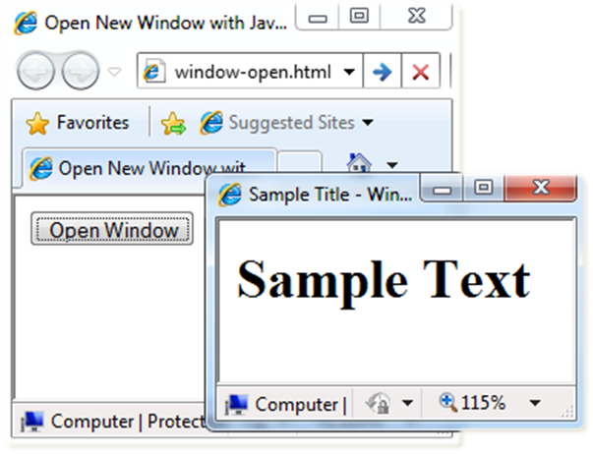
Opening New Window – Example
window.open()
  window-open.html
var newWindow = window.open("", "sampleWindow",
"width=300, height=100, menubar=yes,
status=yes, resizable=yes");
newWindow.document.write(
"<html><head><title>
Sample Title</title>
</head><body><h1>Sample
Text</h1></body>");
newWindow.status =
"Hello folks";

Slide 15
Properties and methods of the “document” Object
Method | Description
clear() | Clears the document window
write(content) | Writes the text of content to a document
writeln() | Writes the text and followed by a carriage return
open() | Open a document to receive data from a write() stream
close() | Closes a write() stream
Property | Description
bgColor | A string value representing the background color of a document
alinkColor | A string value representing the color for active links
location | A string value representing the current URL
title | A string value representing the text specified by <title> tag

Slide 16
Properties and methods of the “history” Object
Method | Description
back() | Sends the user to the previous page in the history list
forward() | Sends the user to the next page in the history list
go(x) | Sends back or forward by “x” number of pages in the history list
Property | Description
length | An integer value representing the number of links in the history object
current | Contains the URL of the current page
next | Contains the URL of the next entry in the history list
previous | Contains the URL of the previous entry in the history list

Slide 17
Form Element-Based Objects
HTML forms can include eight types of input elements
  Text fields, Textarea fields
  Radio buttons
  Check box buttons
  Hidden fields
  Password fields
  Combo box select menu
  List select menu
  Each object has its own properties and methods.

Slide 18
The <form> tag
The <form arguments> ... </form> tag encloses form elements (and probably other elements as well)
The arguments to form tell what to do with the user input
  action="url" (required)
    Specifies where to send the data when the Submit button is clicked
  method="get" (default)
    Form data is sent as a URL with ?form_data info appended to the end
    Can be used only if data is all ASCII and not more than 100 characters
  method="post"
    Form data is sent in the body of the URL request
    Cannot be bookmarked by most browsers
  target="target"
    Tells where to open the page sent as a result of the request
    target= _blank means open in a new window
    target= _top means use the same window

Slide 19
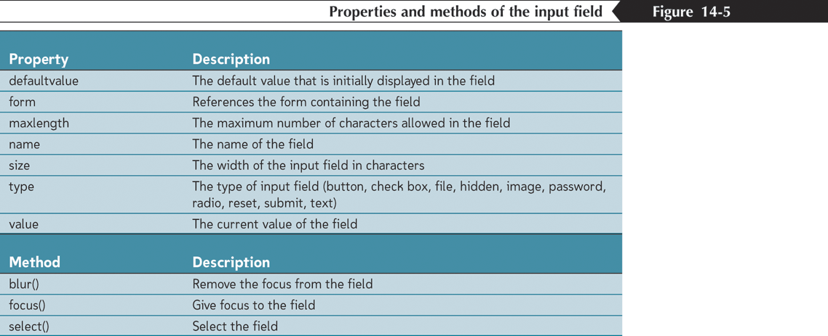
Working with Input Fields
Setting the field value

Slide 20

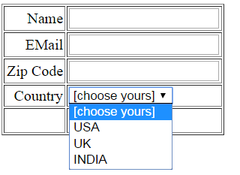

Slide 21
Validation
Basic Validation − First of all, the form must be checked to make sure all the mandatory fields are filled in. It would require just a loop through each field in the form and check for data.
Data Format Validation − Secondly, the data that is entered must be checked for correct form and value. Your code must include appropriate logic to test correctness of data.

Slide 22
Basic Validation – not empty
function validate()
{
if( document.myForm.Name.value == “ " )
{ alert( "Please provide your name!" ); document.myForm.Name.focus() ;
return false; }

Slide 23

if( document.myForm.Country.value == "-1" )
{ alert( "Please provide your country!" );
return false; }

Slide 24
Data Format Validation
if( document.myForm.Zip.value == "" ||
isNaN( document.myForm.Zip.value ) || document.myForm.Zip.value.length != 6 )
{ alert( "Please provide a zip in the format #####." );
document.myForm.Zip.focus() ; return false;
}

Slide 25
String: indexOf() and lastIndexOf()
Search a string
var str = "Hello world, welcome to the universe.";
var n = str.indexOf("welcome");
The result of n will be: 13
Search a string for the last occurrence of a string
var str = "Hello planet earth, you are a great planet.";
var n = str.lastIndexOf("planet");
The result of n will be: 36
Both methods return -1 if the value to search for never occurs.

Slide 26
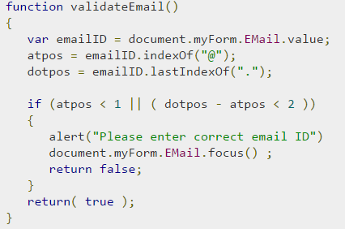
Data Format Validation

Slide 27
Form Validation Script
<html><head>
<title>Form Example</title>
<script LANGUAGE="JavaScript">
function validate() {
if (document.form1.yourname.value.length < 1) {
alert("Please enter your name.");
return false;
}
if (document.form1.address.value.length < 3) {
alert(" Invalid address.");
return false;
}
if (document.form1.phone.value.length < 10) {
alert(“Invalid phone number.");
return false;
}
return true;
}
</script>
</head>
<body>
<h1>Form Example</h1>
<p>Enter the following information. When you press the Display button, the data you entered will be validated, then sent by email.</p>
<form name="form1" action="mailto:user@host.com" enctype="text/plain“ onSubmit="validate();">
<p><b>Name:</b> <input type=“text" length="20" name="yourname">
</p>
<p><b>Address:</b> <input type=“text" length="30" name="address">
</p>
<p><b>Phone: </b> <input type=“text" length="15" name="phone">
</p>
<p><input type=“submit" value="Submit"></p>
</form>
</body>
</html>

Slide 28
Form Validation
<html><head><title>Camp Registration</title>
<script language=“JavaScript">
<!--
function isInt(string) {
var val = parseInt(string);
return(val > 0);
}
function checkRegistration() {
var ageField = document.registerForm.ageField;
if (!isInt(ageField.value)) {
alert("Age must be an integer.");
return(false);
}
...
</script>

Slide 29
Form Validation – Example
  form-validation.html
function checkForm()
{
var valid = true;
if (document.mainForm.firstName.value == "") {
alert("Please type in your first name!");
document.getElementById("firstNameError").
style.display = "inline";
valid = false;
}
return valid;
}
…
<form name="mainForm" onsubmit="return checkForm()">
<input type="text" name="firstName" />
…
</form>

